Slide 1

Introduction to Web Development
Web Development is the process of creating websites or web applications that are accessible over the internet or a private network. It encompasses everything from building simple static pages to complex web-based applications, e-commerce platforms, and social network services.
This presentation will guide you through the fundamentals of web development, explaining how the web works, the essential technologies, and the tools you'll need to get started on your web development journey.
LW
by Liang Wang

Slide 2

Main Categories of Web Development
Front-End Development
Back-End Development
Also known as client-side development, this focuses on what users see and interact with. The primary technologies used are HTML for structure, CSS for styling, and JavaScript for interactivity.
This server-side development handles how the site works behind the scenes. Technologies include Node.js, PHP, Python, Ruby, Java, and C#, which manage data processing and business logic.
Full-Stack Development
This approach combines both front-end and back-end skills, allowing developers to work on all aspects of web application development from user interface to server logic.

Slide 3





How the Web Works
Browser Request
Server Processing
Response Delivery
Browser Display
You type a URL into a browser, which sends a request to the server via the internet using HTTP or HTTPS protocols.
The server receives and processes the request, preparing the appropriate response based on the URL requested.
The server sends back a response, usually containing HTML, CSS, and JavaScript files.
The browser interprets the received files and displays the resulting webpage to the user.

Slide 4
Web Browsing: A Restaurant Analogy
Browser = You (The Customer)
URL = Menu Item
Server = Kitchen
HTML Page = Served Dish
The URL you type is like selecting a specific dish from the menu. It tells the server exactly what you want.
The server processes requests behind the scenes, just as a kitchen prepares meals out of the customer's view.
Just as you visit a restaurant and place an order, your browser makes requests for web content on your behalf.
The final webpage displayed is like the plated meal brought to your table - the end result of the entire process.
Different URLs (menu items) will result in different content being delivered to your browser.
Both transform raw ingredients (data, code) into a finished product for consumption.
You interact with what's delivered, just as you would with the food that arrives at your table.

Slide 5






Components of Web Development
JavaScript (Behavior)
Adds interactivity and dynamic functionality
CSS (Style)
Controls appearance and layout
HTML (Structure)
Provides the foundation and content
These three technologies form the cornerstone of front-end web development. HTML provides the structural foundation of web pages, organizing content into a logical hierarchy. CSS enhances this structure with visual styling, controlling everything from colors and fonts to layout and responsiveness.
JavaScript completes the trio by adding behavior and interactivity, allowing for dynamic content updates, user input validation, and complex functionality without requiring page reloads.

Slide 6
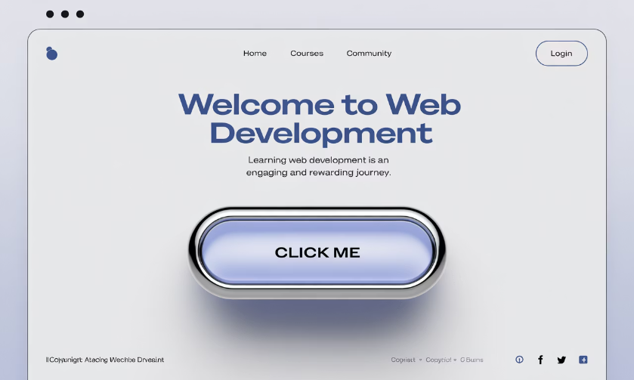
Simple Web Page Example
HTML Code
Result
<!DOCTYPE html>
<html>
<head>
<title>Welcome</title>
<style>
body { font-family: Arial; }
h1 { color: blue; }
</style>
</head>
<body>
<h1>Welcome to Web Development</h1>
<p>Learning HTML, CSS, and JavaScript is fun!</p>
<button onclick="alert('Hello!');">Click Me</button>
</body>
</html>
This example demonstrates how HTML provides structure (headings, paragraphs, buttons), CSS adds style (blue heading, Arial font), and JavaScript adds behavior (the alert when clicking the button).

Slide 7





Essential Web Development Tools
Web Browser
Code Editor
Live Server
Used to view and test web pages. Modern browsers include developer tools for debugging and performance analysis.
Software for writing and editing code with helpful features like syntax highlighting and auto-completion.
Automatically refreshes the browser when you make changes to your code, streamlining the development process.
Popular options: Chrome, Firefox, Safari, Edge
Recommended: Visual Studio Code, Sublime Text, Atom
Git & GitHub
Version control system and platform for tracking changes and collaborating with other developers.

Slide 8










Web Development Workflow
Develop
Plan & Design
Write HTML, CSS, JavaScript, and back-end code
Define project requirements and create wireframes or mockups
Test & Debug
Check functionality across browsers and fix issues
Maintain & Update
Add new features and fix bugs as needed
Deploy
Upload files to a web server and make the site live
Web development is an iterative process that typically follows this cyclical workflow. Each phase builds upon the previous one, and feedback often leads to revisiting earlier stages to make improvements or adjustments.

Slide 9

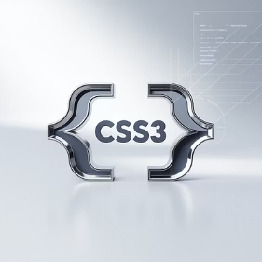
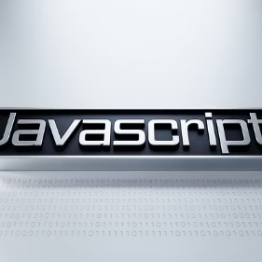






Front-End Development Technologies
Core Technologies
Frameworks & Libraries
Responsive Design
HTML5, CSS3, and JavaScript form the foundation of front-end development, providing structure, style, and interactivity respectively.
React, Angular, and Vue.js are popular JavaScript frameworks that simplify building complex user interfaces with reusable components.
CSS frameworks like Bootstrap and Tailwind CSS help create websites that adapt to different screen sizes and devices.

Slide 10



Back-End Development Technologies
Node.js
Python
PHP
A JavaScript runtime built on Chrome's V8 engine that allows developers to run JavaScript on the server side. It's known for its non-blocking, event-driven architecture that makes it ideal for building scalable network applications.
A versatile programming language popular in web development (using frameworks like Django and Flask), data science, and machine learning. Its clean syntax and extensive libraries make it accessible for beginners and powerful for experts.
A server-side scripting language designed specifically for web development. Despite being one of the older technologies, it powers a significant portion of the web, including WordPress which runs approximately 40% of all websites.

Slide 11
Getting Started: Your First Project
Experiment and Learn
Create Your First HTML File
Modify the text, add colors with CSS, and try adding simple JavaScript functionality like an alert when a button is clicked.
Set Up Your Environment
Create a new file named index.html and add basic HTML structure with a heading, paragraph, and maybe a button.
Install Visual Studio Code as your code editor. It's free, powerful, and has excellent support for web development with helpful extensions.
Use online resources like MDN Web Docs, W3Schools, or freeCodeCamp to learn more as you build.
Save the file and open it in your browser to see your creation.
Set up a browser with developer tools enabled (Chrome or Firefox recommended).
The best way to learn web development is by doing. Start with small projects and gradually increase complexity as you become more comfortable. Don't be afraid to experiment and make mistakes—they're valuable learning opportunities.

